Slide 1

CS 584 Machine Learning
Week 9
October 17, 2018

Slide 2

Week 9 Agenda: Dimension Reduction
Feature Selection
Principal Component
Chapter 6 of the Machine Learning book

Slide 3
Feature Selection Before Model Selection
In the era of Big Data (including Noisy Data), Model Selection is not the first thing to do
Resources (e.g., memory, disk space, CPU speed) limit the number of variables that you can feed into a computer program
The machine is not very good at dealing with collinearity (most, if not all, computer program simply choose one and throw away others to deal with collinearity)
We need a good practice of selecting features!

Slide 4
Feature Selection
Select features based on business practice
Select features to discard the “bad apples” or “troublemakers”
If you have a difficult time choosing one over the others, then consider combining features

Slide 5
Feature Selection – Business Practice
Features that must be considered whatsoever due to business practice
Geographical tiers in insurance ratemaking
Marketing incentive in customer purchase behavior
Features that must never be included to avoid regulatory issues or legal litigations
Race, Gender, Age, Disability Status are avoided in human resources analytics
Protected Health Information and Personally Identifiable Information are seldom used to minimize the chance of any breach of privacy.

Slide 6
Feature Selection – “Troublemakers”
Features that vary too much or too little
Record identifiers (unique value for each record)
Constant or nearly constant features (percent of observations tie to a particular value must be less than a threshold)
Features that are practically all missing values
Percent of non-missing observations must be above a threshold
Features that vary over a narrow range relative to others
Unit of measurement may not be appropriate (e.g., the distance of your house from nearest fire hydrant should not in inches or miles)

Slide 7
Feature Selection – “Collinearity”
A common response is to include some data-healthy features that are easy for interpretations and drop others
Another response is to combine the features
When there are no obvious champions and the predictors are compatible in the units of measurement, then consider combining them linearly using the Principal Component Analysis.

Slide 8
Principal Component: Overview
A dimension-reduction tool that is particularly useful when there are a substantial number of correlated features.
Instead of requiring us to drop some features, it transforms the set of correlated features to another set of uncorrelated features in descending level of accountability of the total variance.
Originated by Pearson (1901) and later developed by Hotelling (1933).
Pearson, Karl (1901). “On Lines and Planes of Closest Fit to Systems of Points in Space.” Philosophical Magazine, 6, 559–572.
Hotelling, Harold (1933). “Analysis of a Complex of Statistical Variables into Principal Components.” Journal of Educational Psychology, 24, 417–441 and 498–520.

Slide 9
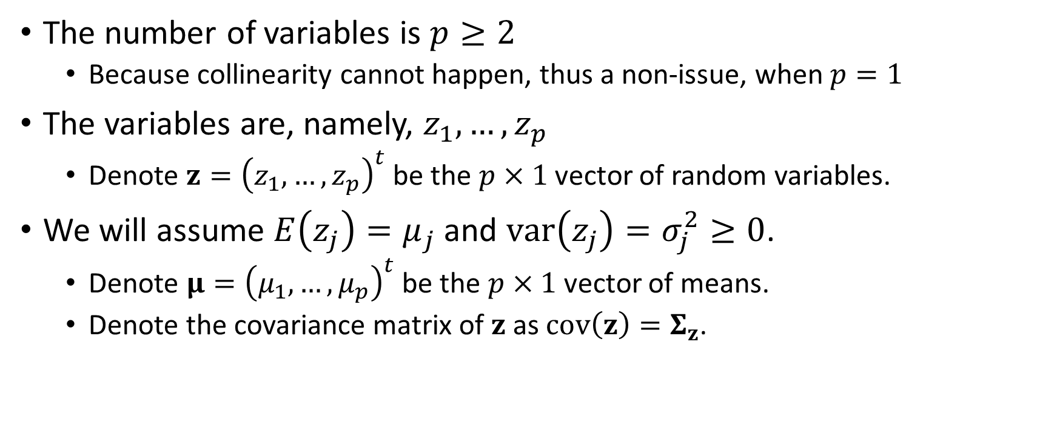
Principal Component: The Training Data
The number of variables is $p≥2$
Because collinearity cannot happen, thus a non-issue, when $p=1$
The variables are, namely, $z_{1},…,z_{p}$
Denote $z={\left(z_{1},…,z_{p}\right)}^{t}$ be the $p×1$ vector of random variables.
We will assume $E\left(z_{j}\right)=μ_{j}$ and $var\left(z_{j}\right)=σ_{j}^{2}≥0$.
Denote $μ={\left(μ_{1},…,μ_{p}\right)}^{t}$ be the $p×1$ vector of means.
Denote the covariance matrix of $z$ as $cov\left(z\right)=Σ_{z}$.

Slide 10
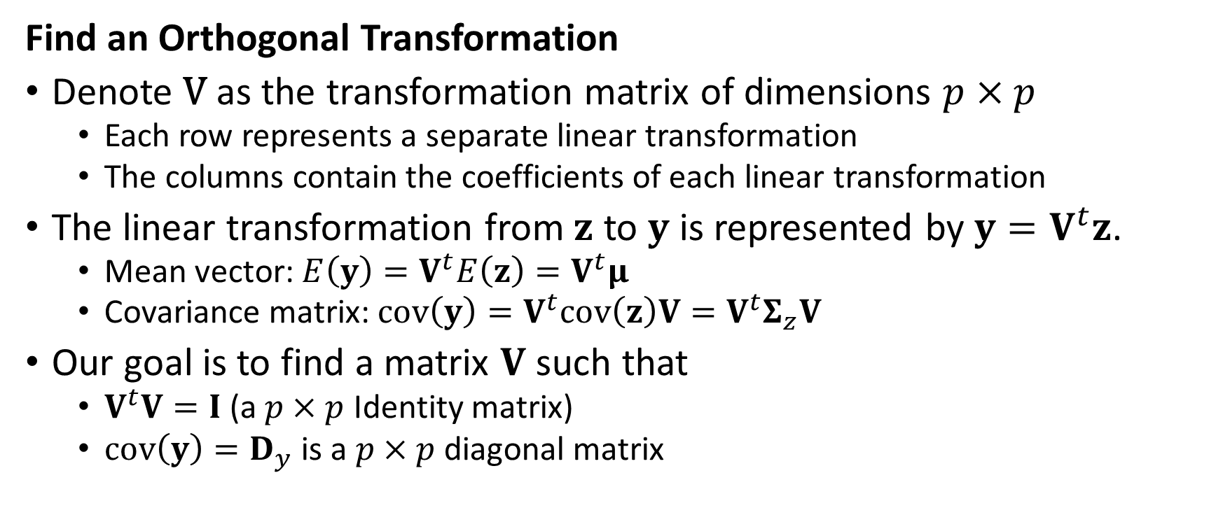
Principal Component: Transformation
Find an Orthogonal Transformation
Denote V as the transformation matrix of dimensions $p×p$
Each row represents a separate linear transformation
The columns contain the coefficients of each linear transformation
The linear transformation from $z$ to $y$ is represented by $y=V^{t}z$.
Mean vector: $E\left(y\right)=V^{t}E\left(z\right)=V^{t}μ$
Covariance matrix: $cov\left(y\right)=V^{t}cov\left(z\right)V=V^{t}Σ_{z}V$
Our goal is to find a matrix $V$ such that
$V^{t}V=I$ (a $p×p$ Identity matrix)
$cov\left(y\right)=D_{y}$ is a $p×p$ diagonal matrix

Slide 11
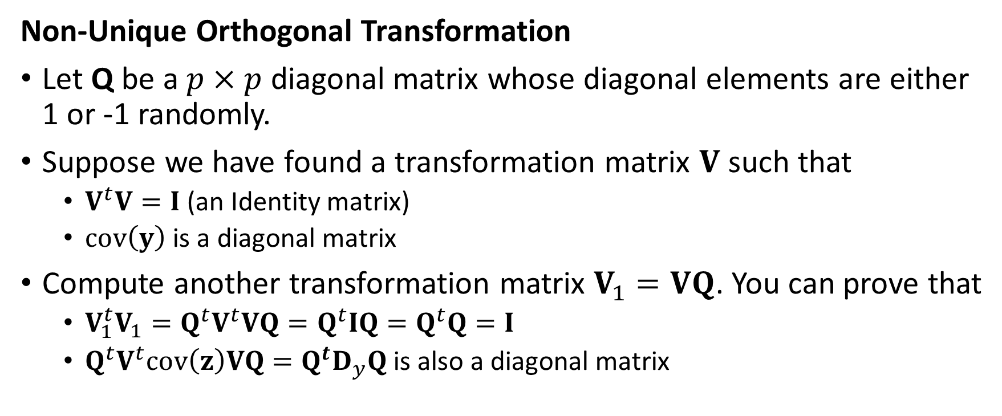
Principal Component: Transformation
Non-Unique Orthogonal Transformation
Let Q be a $p×p$ diagonal matrix whose diagonal elements are either 1 or -1 randomly.
Suppose we have found a transformation matrix $V$ such that
$V^{t}V=I$ (an Identity matrix)
$cov\left(y\right)$ is a diagonal matrix
Compute another transformation matrix $V_{1}=VQ$. You can prove that
$V_{1}^{t}V_{1}=Q^{t}V^{t}VQ=Q^{t}IQ=Q^{t}Q=I$
${Q^{t}V}^{t}cov\left(z\right)VQ=Q^{t}D_{y}Q$ is also a diagonal matrix

Slide 12
Principal Component: Transformation
Find the Unique Orthogonal Transformation
Hotelling (1933) derived the “principal components” solution.
Harold Hotelling (1895 – 1973).
In an essence, we want a solution such that the variance of the j^{th} principal component is maximized subject to the constraint that the transformation is orthonormalized.

Slide 13
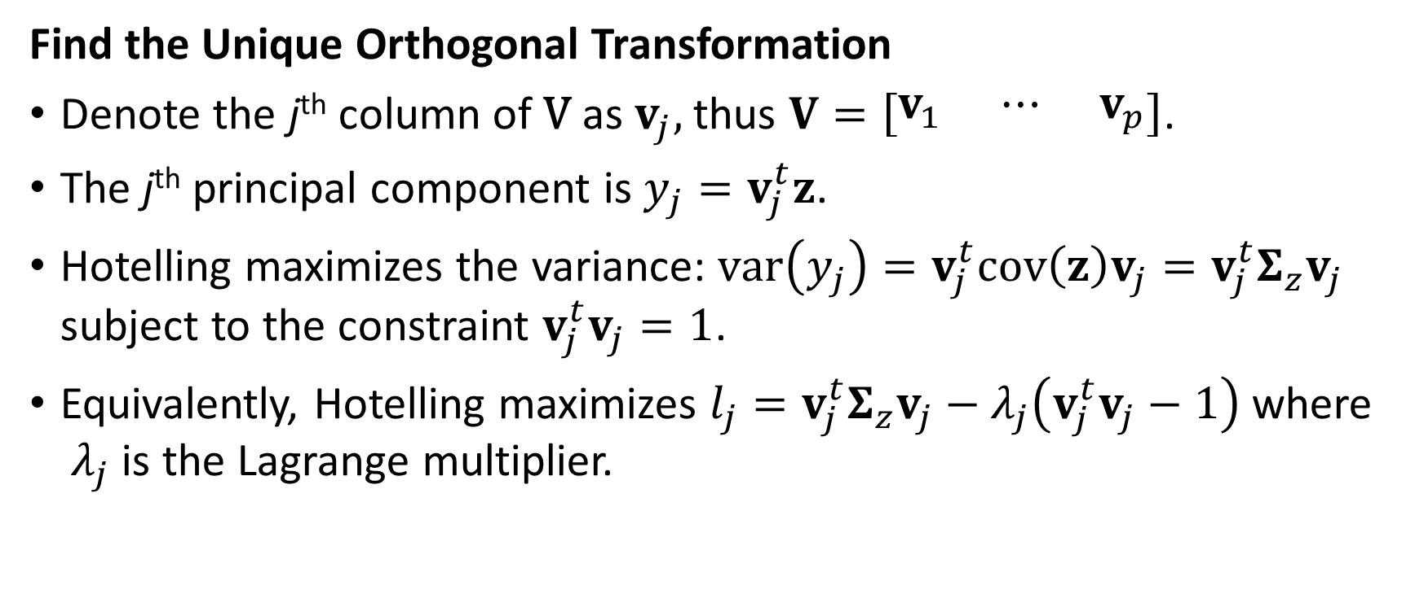
Principal Component: Transformation
Find the Unique Orthogonal Transformation
Denote the j^{th} column of V as $v_{j},$ thus $V=\left[\begin{matrix}v_{1} & ⋯ & v_{p}\end{matrix}\right]$.
The j^{th} principal component is $y_{j}=v_{j}^{t}z$.
Hotelling maximizes the variance: $var\left(y_{j}\right)=v_{j}^{t}cov\left(z\right)v_{j}=v_{j}^{t}Σ_{z}v_{j}$ subject to the constraint $v_{j}^{t}v_{j}=1$.
Equivalently, Hotelling maximizes $l_{j}=v_{j}^{t}Σ_{z}v_{j}−λ_{j}\left(v_{j}^{t}v_{j}−1\right)$ where ${ λ}_{j}$ is the Lagrange multiplier.

Slide 14
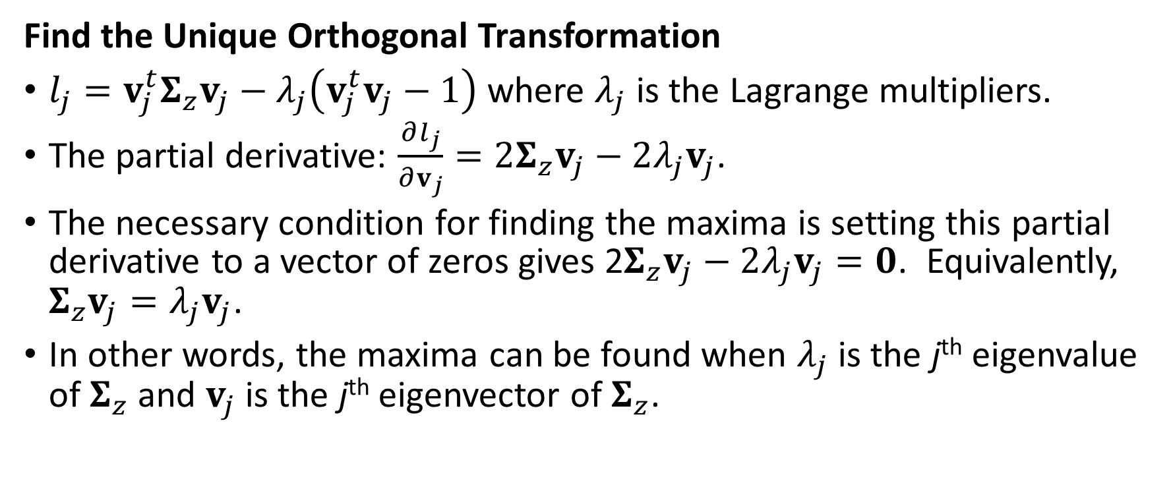
Principal Component: Transformation
Find the Unique Orthogonal Transformation
$l_{j}=v_{j}^{t}Σ_{z}v_{j}−λ_{j}\left(v_{j}^{t}v_{j}−1\right)$ where $λ_{j}$ is the Lagrange multipliers.
The partial derivative: $\frac{∂l_{j}}{∂v_{j}}=2Σ_{z}v_{j}−2λ_{j}v_{j}$.
The necessary condition for finding the maxima is setting this partial derivative to a vector of zeros gives 2$Σ_{z}v_{j}−2λ_{j}v_{j}=0$. Equivalently, $Σ_{z}v_{j}=λ_{j}v_{j}$.
In other words, the maxima can be found when $λ_{j}$ is the j^{th} eigenvalue of $Σ_{z}$ and $v_{j}$ is the j^{th} eigenvector of $Σ_{z}$.

Slide 15
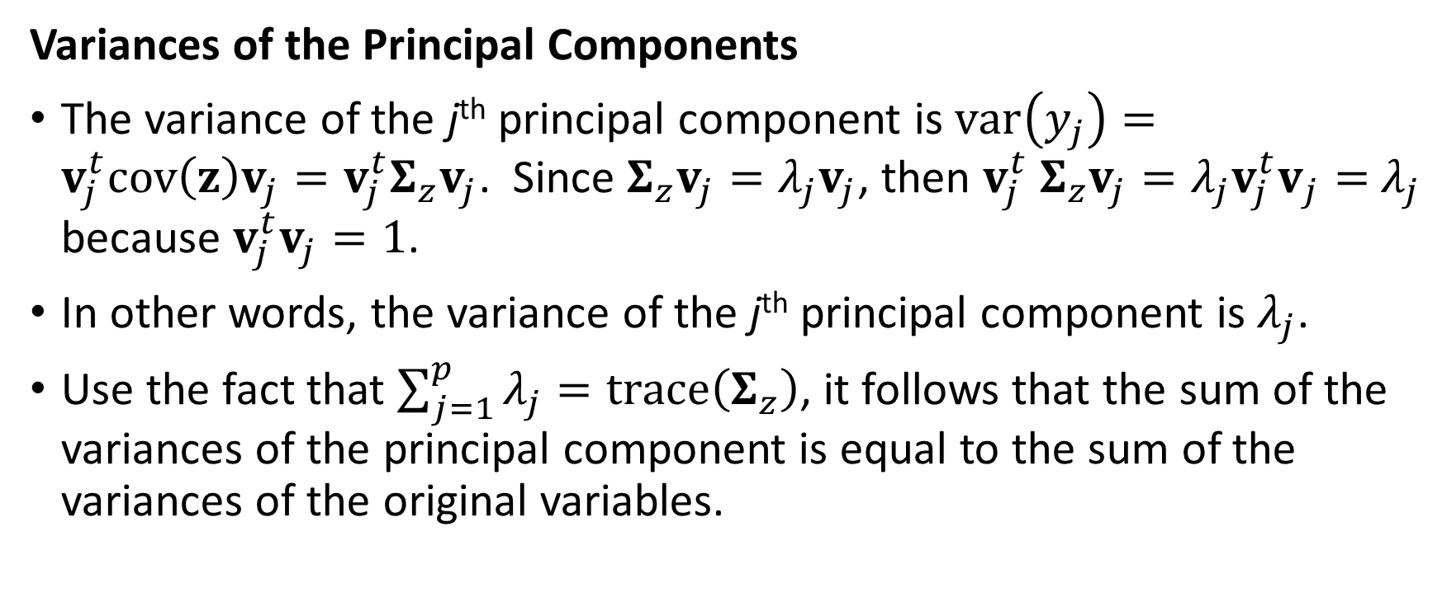
Principal Component: Variances
Variances of the Principal Components
The variance of the j^{th} principal component is $var\left(y_{j}\right)=v_{j}^{t}cov\left(z\right)v_{j}=v_{j}^{t}Σ_{z}v_{j}$. Since $Σ_{z}v_{j}=λ_{j}v_{j}$, then $v_{j}^{t} Σ_{z}v_{j}=λ_{j}{v_{j}^{t}v}_{j}=$ $λ_{j}$ because $v_{j}^{t}v_{j}=1$.
In other words, the variance of the j^{th} principal component is $λ_{j}$.
Use the fact that $\sum_{j=1}^{p}{λ_{j}}=trace\left(Σ_{z}\right)$, it follows that the sum of the variances of the principal component is equal to the sum of the variances of the original variables.

Slide 16
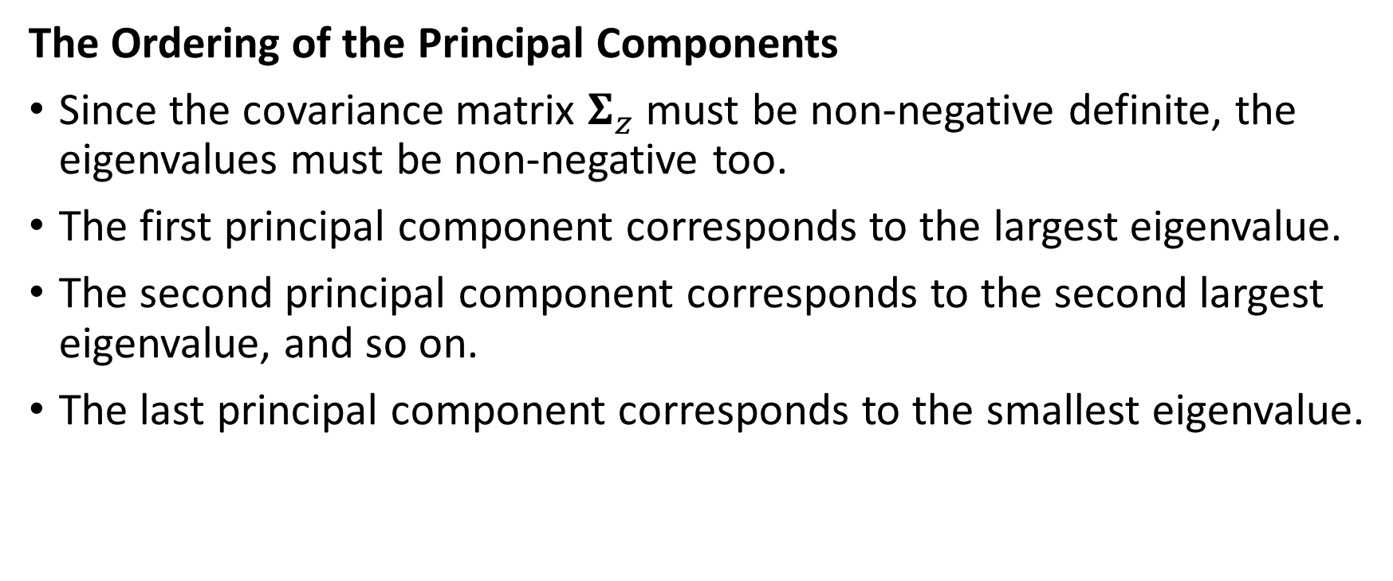
Principal Component: Ordering
The Ordering of the Principal Components
Since the covariance matrix $Σ_{z}$ must be non-negative definite, the eigenvalues must be non-negative too.
The first principal component corresponds to the largest eigenvalue.
The second principal component corresponds to the second largest eigenvalue, and so on.
The last principal component corresponds to the smallest eigenvalue.

Slide 17
Principal Component: Example
numpy.random.seed(1017)
z0 = numpy.random.normal(loc = 0.0, scale = 1.0, size = 5000)
z1 = numpy.random.uniform(low = -numpy.sqrt(3), high = numpy.sqrt(3), size = 5000)
z2 = (z0 + z1) / numpy.sqrt(2)
z3 = (z0 - z1) / numpy.sqrt(2)
z = pandas.DataFrame()
z['z0'] = z0
z['z1'] = z1
z['z2'] = z2
z['z3'] = z3

Slide 18
Principal Component: Example
print('Descriptive Statistics: \n', z.describe())
# Calculate the Correlations among the variables
zCorrelation = z.corr(method = 'pearson', min_periods = 1)
print('Empirical Correlation: \n', zCorrelation)
Descriptive Statistics
 | z0 | z1 | z2 | z3
count | 5000 | 5000 | 5000 | 5000
mean | -0.022804 | -0.002476 | -0.017876 | -0.014374
std | 1.00853 | 0.994521 | 1.005456 | 0.997629
min | -3.927028 | -1.731972 | -3.21066 | -3.374742
25% | -0.680362 | -0.864244 | -0.731999 | -0.717231
50% | -0.033509 | -0.014367 | -0.021156 | -0.032936
75% | 0.634985 | 0.843666 | 0.670243 | 0.690334
max | 3.995817 | 1.731765 | 3.052465 | 2.992758
Empirical Correlation:
 | z0 | z1 | z2 | z3
z0 | 1 | 0.007816 | 0.714735 | 0.709324
z1 | 0.007816 | 1 | 0.70496 | -0.699317
z2 | 0.714735 | 0.70496 | 1 | 0.013988
z3 | 0.709324 | -0.699317 | 0.013988 | 1

Slide 19
Principal Component: Example
# Eigenvalue decomposition
evals, evecs = numpy.linalg.eigh(zCorrelation)
Index | Eigenvalues
0 | -1.11528802153434E-15
1 | 1.11528802138873E-15
2 | 1.98397629940875E+00
3 | 2.01602370059124E+00
Eigenvectors (as columns)
0 | 1 | 2 | 3
7.08757310538143E-01 | 3.38121090123292E-02 | 1.76267215000527E-01 | -6.82238730180890E-01
3.08260123592772E-02 | -7.03943128942986E-01 | -6.86328160951320E-01 | -1.80187357106876E-01
-5.21676376848988E-01 | 4.79400053483425E-01 | -3.55008460802516E-01 | -6.09916665878568E-01
-4.73884574087905E-01 | -5.22968833888009E-01 | 6.09797111472138E-01 | -3.60672277924953E-01
Check
The Trace of the Empirical Correlation is 4
The Sum of all 4 Eigenvalues is 3.99999999999999

Slide 20
Principal Component: Example
import sklearn.decomposition as decomposition
myPCA = decomposition.PCA(n_components = 4, svd_solver = 'full')
myPCA.fit(z)
print("Mean: \n", myPCA.mean_)
print('Explained Variance: \n', myPCA.explained_variance_)
print('Explained Variance Ratio: \n', myPCA.explained_variance_ratio_)
print('Principal Components: \n', myPCA.components_)

Slide 21
Principal Component: Example
Mean:
[-0.02280405 -0.00247609 -0.01787576 -0.01437404]
Explained Variance:
[2.03834744e+00 1.97405981e+00 2.53888532e-31 2.31017544e-32]
Mean is per-feature empirical mean, estimated from the training set.
Descriptive Statistics
 | z0 | z1 | z2 | z3
count | 5000 | 5000 | 5000 | 5000
mean | -0.022804 | -0.002476 | -0.017876 | -0.014374
Index | Eigenvalues
0 | -1.11528802153434E-15
1 | 1.11528802138873E-15
2 | 1.98397629940875E+00
3 | 2.01602370059124E+00
Explained Variance is the amount of variance explained by each of the selected components. In other words, it is the eigenvalue

Slide 22
Principal Component: Example
Explained Variance Ratio:
[5.08011104e-01 4.91988896e-01 6.32758631e-32 5.75757968e-33]
Principal Components:
[[ 0.68428497 0.17819676 0.60986668 0.3578584 ]
[-0.17819676 0.68428497 0.3578584 -0.60986668]
[-0.67025603 -0.22529283 0.63324867 0.31463649]
[-0.22529283 0.67025603 -0.31463649 0.63324867]]
Explained Variance Ratio is the Explained Variance divided by the sum of the eigenvalues.
These are the Principal Components. Each column contains the coefficients for the linear transformation. The order of the columns corresponds to that of the Explained Variance.

Slide 23
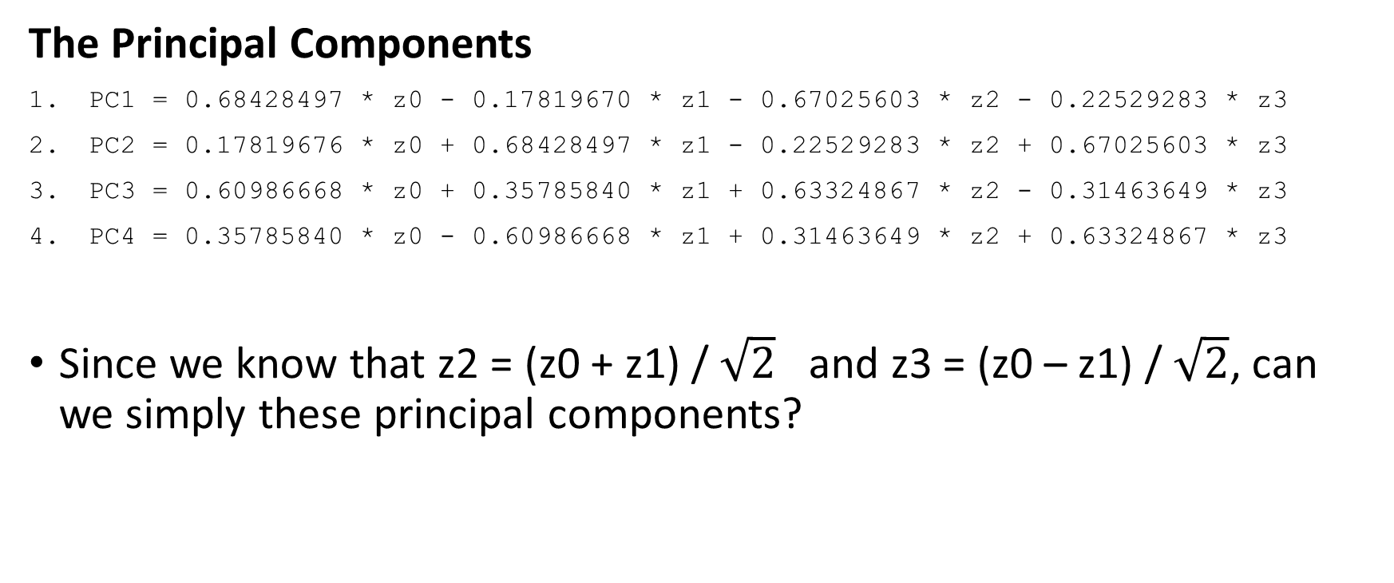
Principal Component: Example
The Principal Components
PC1 = 0.68428497 * z0 - 0.17819670 * z1 - 0.67025603 * z2 - 0.22529283 * z3
PC2 = 0.17819676 * z0 + 0.68428497 * z1 - 0.22529283 * z2 + 0.67025603 * z3
PC3 = 0.60986668 * z0 + 0.35785840 * z1 + 0.63324867 * z2 - 0.31463649 * z3
PC4 = 0.35785840 * z0 - 0.60986668 * z1 + 0.31463649 * z2 + 0.63324867 * z3
Since we know that z2 = (z0 + z1) / $\sqrt{2}$ and z3 = (z0 – z1) / $\sqrt{2}$, can we simply these principal components?

Slide 24
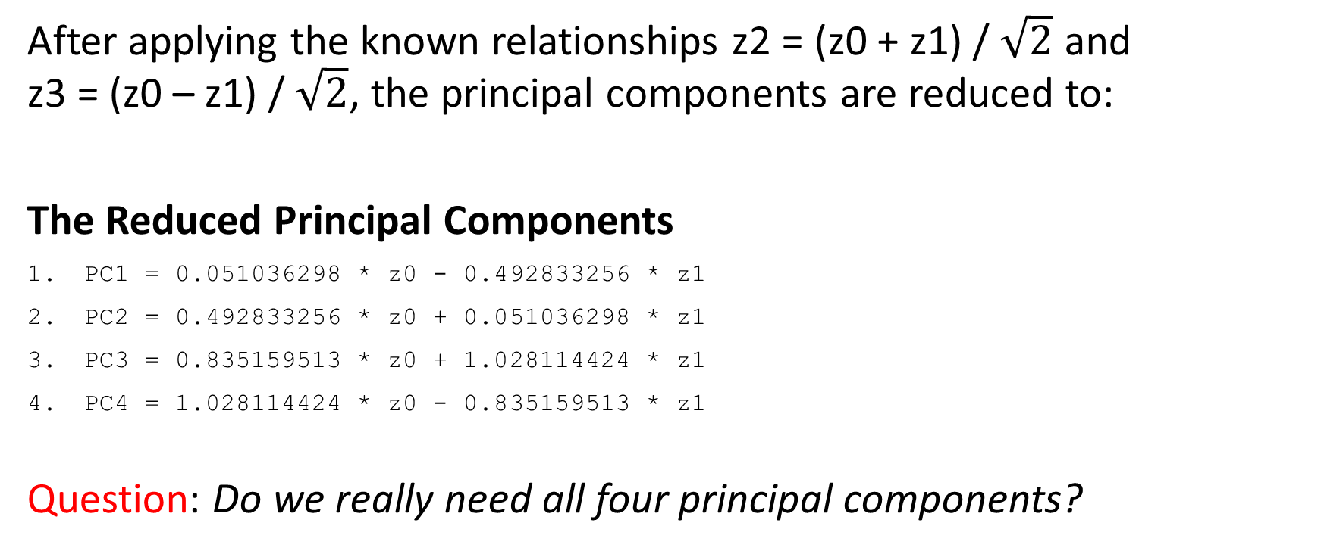
Principal Component: Example
After applying the known relationships z2 = (z0 + z1) / $\sqrt{2}$ and z3 = (z0 – z1) / $\sqrt{2}$, the principal components are reduced to:
The Reduced Principal Components
PC1 = 0.051036298 * z0 - 0.492833256 * z1
PC2 = 0.492833256 * z0 + 0.051036298 * z1
PC3 = 0.835159513 * z0 + 1.028114424 * z1
PC4 = 1.028114424 * z0 - 0.835159513 * z1
Question: Do we really need all four principal components?
Remarks:
PC1 is dominated by z1
PC2 is dominated by z0
PC3 is practically the sum of z0 and z1
PC4 is practically the difference of z0 and z1

Slide 25
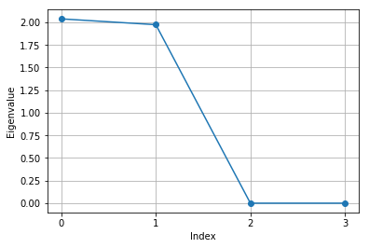
Principal Component: Number of Components
Question: Do we really need all four principal components?
Task: Plot the eigenvalues (or the Explained Variance) against the index. Count the number of eigenvalues which are greater than one.
Observation: It seems to me that it is sufficient to take the first two principal components.

Slide 26
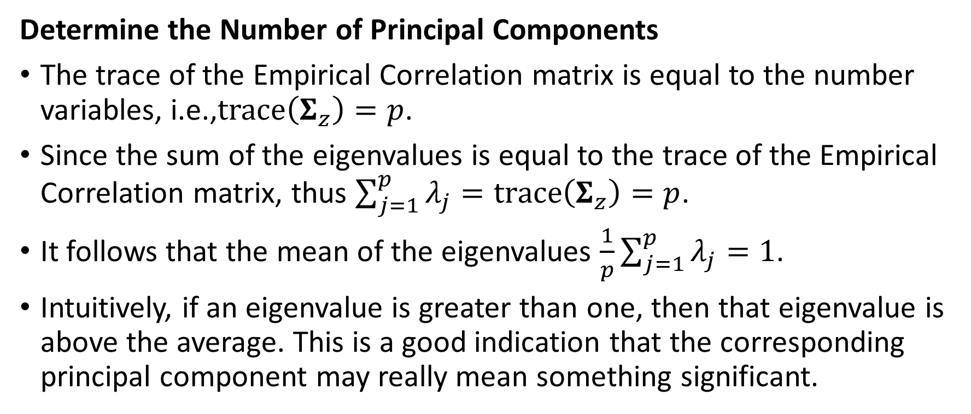
Principal Component: Rationale
Determine the Number of Principal Components
The trace of the Empirical Correlation matrix is equal to the number variables, i.e.,$trace\left(Σ_{z}\right)=p$.
Since the sum of the eigenvalues is equal to the trace of the Empirical Correlation matrix, thus $\sum_{j=1}^{p}{λ_{j}}=trace\left(Σ_{z}\right)=p$.
It follows that the mean of the eigenvalues $\frac{1}{p}\sum_{j=1}^{p}{λ_{j}}=1$.
Intuitively, if an eigenvalue is greater than one, then that eigenvalue is above the average. This is a good indication that the corresponding principal component may really mean something significant.

Slide 27
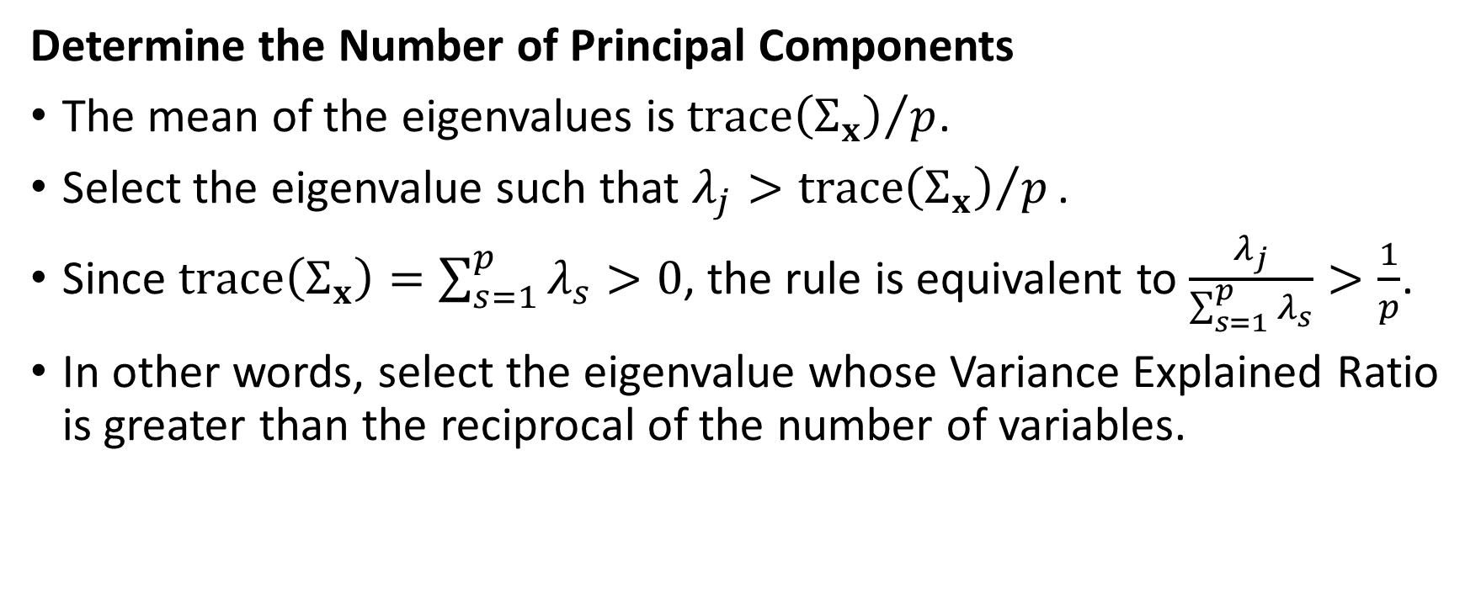
Principal Component: The General Case
Determine the Number of Principal Components
The mean of the eigenvalues is ${trace\left(Σ_{x}\right)}/p$.
Select the eigenvalue such that $λ_{j}>{trace\left(Σ_{x}\right)}/p\text{.}$
Since $trace\left(Σ_{x}\right)=\sum_{s=1}^{p}{λ_{s}}>0$, the rule is equivalent to $\frac{λ_{j}}{\sum_{s=1}^{p}{λ_{s}}}>\frac{1}{p}$.
In other words, select the eigenvalue whose Variance Explained Ratio is greater than the reciprocal of the number of variables.

Slide 28
Principal Component: Example
U.S. Treasury Rate
The daily market rates of U.S. Treasury products
Bill: Bill_1Month, Bill_3Month, Bill_6Month, Bill_1Year
Note: Note_2Year, Note_3Year, Note_5Year, Note_7Year, Note_10Year
Bond: Bond_20Year, Bond_30Year
From January 2, 2018 to October 12, 2018
It is commonly known that these rates are highly correlated.
After all, they are all some kind of interest rates!

Slide 29
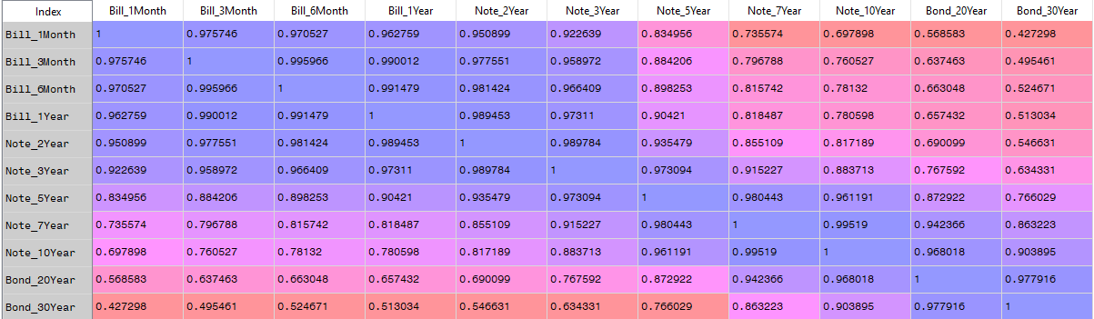
Principal Component: Correlations

Slide 30
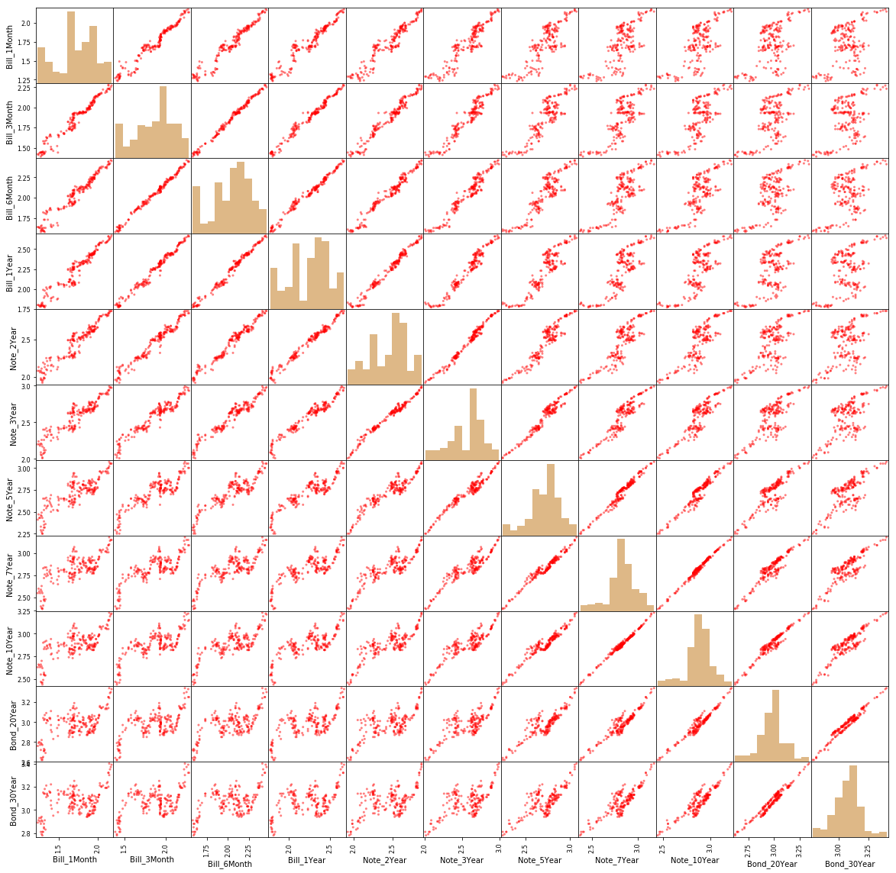
Principal Component: Scatterplot Matrix
Treasury Bills
Treasury Notes
Treasury Bonds

Slide 31
Principal Component: Explained Variance
The Explained Variances (i.e., the eigenvalues) are:
[3.92300471e-01 3.26343809e-02 3.48702900e-03 1.70994716e-03 6.16602704e-04 2.88972839e-04 1.73742209e-04 7.43246504e-05 5.76629315e-05 2.65093244e-05 1.35176301e-05]
The Cumulative Sum of Explained Variances Ratios are:
[0.90940145 0.98505202 0.99313538 0.99709926 0.99852862 0.99919849 0.99960125 0.99977354 0.99990721 0.99996866 1.]

Slide 32
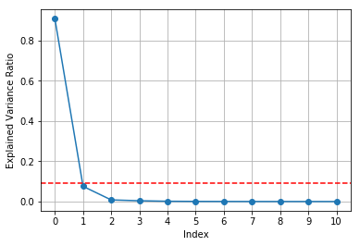
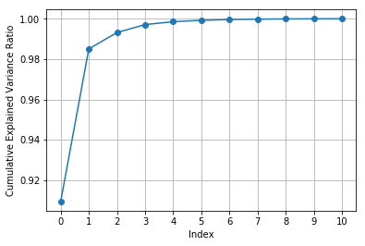
Principal Component: Explained Variance
The first two principal components account for 98.5052% of the total variance.

Slide 33
Principal Component: First Two Components
The first principal component is dominated by the Treasury Bills
The second principal component is dominated by the 5-Year Note, 2-Year Note, 1-Year Bill, and 1-Month Bill
 | PC1 | PC2
Bill_1Month | -0.38 | -0.37
Bill_3Month | -0.34 | -0.21
Bill_6Month | -0.55 | -0.18
Bill_1Year | 0.65 | -0.33
Note_2Year | -0.11 | 0.45
Note_3Year | -0.10 | 0.09
Note_5Year | 0.05 | -0.68
Note_7Year | 0.02 | -0.08
Note_10Year | -0.01 | 0.03
Bond_20Year | 0.00 | -0.01
Bond_30Year | -0.02 | 0.00

Slide 34
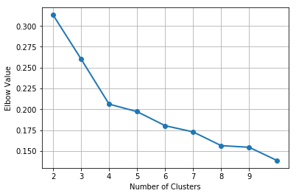
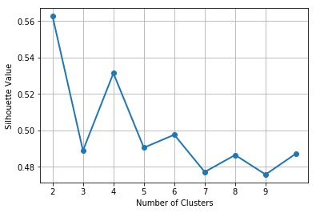
Principal Component: Clustering
Using the first two principal components, identify clusters.
The Elbow chart and the Silhouette chart indicate that there are four clusters.

Slide 35
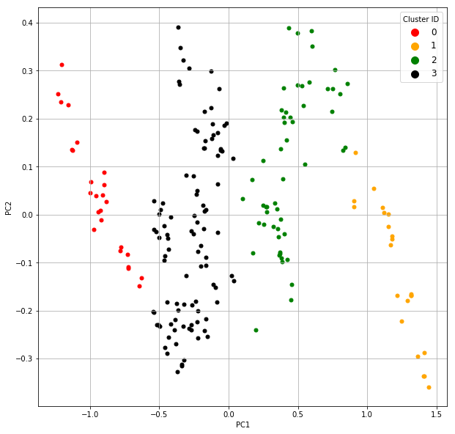
Principal Component: Clustering
Cluster 0
Low PC1
PC2 inversely proportional to PC1
Cluster 1
Lower mid-range PC1
Cluster 2
Upper mid-range PC1
PC2 slightly proportional to PC1
Cluster 3
High PC1
PC2 inversely proportional to PC1

Slide 36
Principal Components: Summary
Principal components are linear combinations of the features
Principal components maximize the variances of the linear combinations.
Principal components are calculated by decomposing a covariance matrix into its eigenvalues and the corresponding eigenvectors.
The eigenvectors are the coefficients of the linear combinations
The eigenvalues are the variances of the linear combinations.
Use the magnitudes of the eigenvalues to deduce the number of principal components needed.
Use a few major principal components to get some understandings of the relationships in the data.
Does not need or use information about the target variable.

Slide 37
Office Hours
Instructor, Dr. Lam
mlam5@iit.edu
Mondays / 4 PM to 5 PM / Room 228A, Stuart Building
Except for the Fall Break on October 8
Teaching Assistant, Mr. Jing Zhao
jzhao29@hawk.iit.edu
Thursdays / 2 PM to 3 PM / Room 019A, Stuart Building

